Slide 1
Parkinson's Disease Predictive Machine Learning Model
Luna Pérez Troncoso

Slide 2
Introduction
The early detection of PD is a growing priority within both clinical practice and research.

Slide 3
Introduction
The early detection of PD is a growing priority within both clinical practice and research.
Many individuals remain undiagnosed until the disease has already progressed, limiting the effectiveness of available therapeutic interventions.

Slide 4
Introduction
The early detection of PD is a growing priority within both clinical practice and research.
Many individuals remain undiagnosed until the disease has already progressed, limiting the effectiveness of available therapeutic interventions. Consequently, timely diagnosis can significantly influence patient outcomes and long-term quality of life.

Slide 5
Introduction
The early detection of PD is a growing priority within both clinical practice and research.
Many individuals remain undiagnosed until the disease has already progressed, limiting the effectiveness of available therapeutic interventions. Consequently, timely diagnosis can significantly influence patient outcomes and long-term quality of life.
Early identification could allow for timelier monitoring, lifestyle adjustments, and targeted therapeutic strategies that may slow disease progression or improve quality of life.

Slide 6
Why develop a predictive model?
01
A reliable predictive system has the potential to support clinicians in recognizing subtle signs that might otherwise go unnoticed.

Slide 7
Why develop a predictive model?
01
A reliable predictive system has the potential to support clinicians in recognizing subtle signs that might otherwise go unnoticed.

Slide 8
Why develop a predictive model?
01
A reliable predictive system has the potential to support clinicians in recognizing subtle signs that might otherwise go unnoticed.
Predictive modeling can help researchers gain deeper insight into the complex interactions that contribute to the onset of neurodegenerative disorders
02

Slide 9
Why develop a predictive model?
01
A reliable predictive system has the potential to support clinicians in recognizing subtle signs that might otherwise go unnoticed.
Predictive modeling can help researchers gain deeper insight into the complex interactions that contribute to the onset of neurodegenerative disorders
02

Slide 10
Why develop a predictive model?
01
A reliable predictive system has the potential to support clinicians in recognizing subtle signs that might otherwise go unnoticed.
Predictive modeling can help researchers gain deeper insight into the complex interactions that contribute to the onset of neurodegenerative disorders
02
Beyond clinical impact, creating a predictive model encourages the integration of modern data-driven approaches into neurological healthcare, which stands out as a promising path to more personalized and proactive patient care.
03

Slide 11
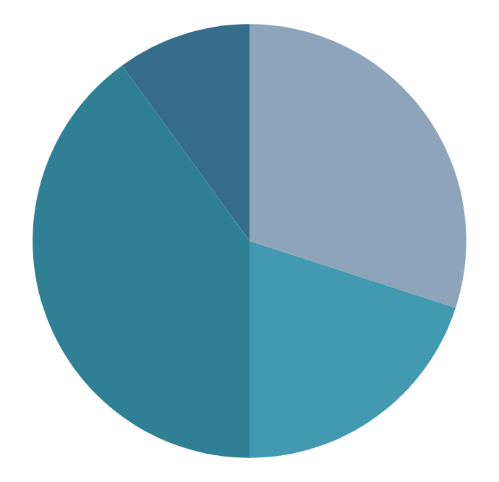
Objective
Integrating diverse variables (demographic, lifestyle, clinical, cognitive, and symptom-related variables) into a unified predictive framework, the project seeks to evaluate multiple machine learning algorithms and determine their capability to accurately identify patients at risk.

Slide 12
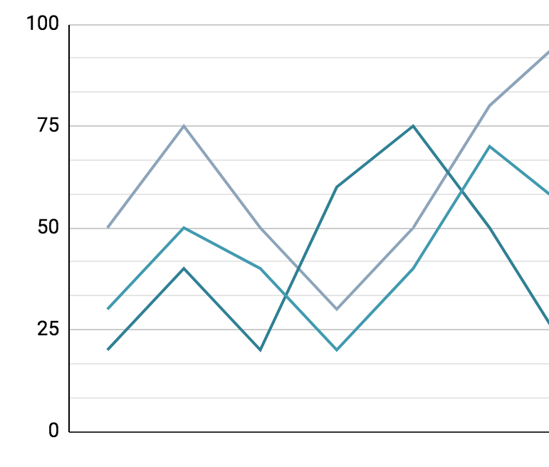
Data Description and Sources
As part of this project, I selected a synthetic dataset from Kaggle generated by Mr. Rabie El Kharoua, to support the development of a predictive model for Parkinson’s disease.

Slide 13
Data Description and Sources
As part of this project, I selected a synthetic dataset from Kaggle generated by Mr. Rabie El Kharoua, to support the development of a predictive model for Parkinson’s disease.
This dataset contains diverse features:

Slide 14
Data Description and Sources
As part of this project, I selected a synthetic dataset from Kaggle generated by Mr. Rabie El Kharoua, to support the development of a predictive model for Parkinson’s disease.
This dataset contains diverse features:
Demographic variables (age, gender, ethnicity, educational level).

Slide 15
Data Description and Sources
As part of this project, I selected a synthetic dataset from Kaggle generated by Mr. Rabie El Kharoua, to support the development of a predictive model for Parkinson’s disease.
This dataset contains diverse features:
Demographic variables (age, gender, ethnicity, educational level).
Lifestyle Factors (BMI, smoking, alcohol, physical activity, diet and sleep quality).

Slide 16
Data Description and Sources
As part of this project, I selected a synthetic dataset from Kaggle generated by Mr. Rabie El Kharoua, to support the development of a predictive model for Parkinson’s disease.
This dataset contains diverse features:
Demographic variables (age, gender, ethnicity, educational level).
Lifestyle Factors (BMI, smoking, alcohol, physical activity, diet and sleep quality).
Medical History (TBI, Depression, Stroke, Diabetes…)

Slide 17
Data Description and Sources
As part of this project, I selected a synthetic dataset from Kaggle generated by Mr. Rabie El Kharoua, to support the development of a predictive model for Parkinson’s disease.
This dataset contains diverse features:
Demographic variables (age, gender, ethnicity, educational level).
Lifestyle Factors (BMI, smoking, alcohol, physical activity, diet and sleep quality).
Medical History (TBI, Depression, Stroke, Diabetes…)
Clinical Meassurements(Cholesterol, Triglycerides, BP).

Slide 18
Data Description and Sources
As part of this project, I selected a synthetic dataset from Kaggle generated by Mr. Rabie El Kharoua, to support the development of a predictive model for Parkinson’s disease.
This dataset contains diverse features:
Demographic variables (age, gender, ethnicity, educational level).
Lifestyle Factors (BMI, smoking, alcohol, physical activity, diet and sleep quality).
Medical History (TBI, Depression, Stroke, Diabetes…)
Clinical Meassurements(Cholesterol, Triglycerides, BP).
Cognitive and Functional Assessments (UPDRS, MoCA…).

Slide 19
Data Description and Sources
As part of this project, I selected a synthetic dataset from Kaggle generated by Mr. Rabie El Kharoua, to support the development of a predictive model for Parkinson’s disease.
This dataset contains diverse features:
Demographic variables (age, gender, ethnicity, educational level).
Lifestyle Factors (BMI, smoking, alcohol, physical activity, diet and sleep quality).
Medical History (TBI, Depression, Stroke, Diabetes…)
Clinical Meassurements(Cholesterol, Triglycerides, BP).
Cognitive and Functional Assessments (UPDRS, MoCA…).
Symptom indicators (Tremor, Constipation, Rigidity).

Slide 20
Methodology
01
Standarization/Scaling
StandarScaler MinMaxScaler or None

Slide 21
Methodology
01
02
Standarization/Scaling
Imbalance Correction
StandarScaler MinMaxScaler or None
SMOTENC or None

Slide 22
Methodology
01
02
03
Standarization/Scaling
Imbalance Correction
Feature Selection or
Dimensionality Reduction
StandarScaler MinMaxScaler or None
SMOTENC or None
SelectKBest, RFECV, LinearDiscriminantAnalysis or None

Slide 23
Methodology
01
02
03
Standarization/Scaling
Imbalance Correction
Feature Selection or
Dimensionality Reduction
StandarScaler MinMaxScaler or None
SMOTENC or None
SelectKBest, RFECV, LinearDiscriminantAnalysis or None
04
Classification Models
LogisticRegression, QuadraticDiscriminantAnalysis, LinearSVC, SVC, KNeighborsClassifier, XGBClassifier, LGBMClassifier, RandomForestClassifier, ExtraTreesClassifier, StackingClassifier, VotingClassifier

Slide 24
Methodology
01
02
03
Standarization/Scaling
Imbalance Correction
Feature Selection or
Dimensionality Reduction
StandarScaler MinMaxScaler or None
SMOTENC or None
SelectKBest, RFECV, LinearDiscriminantAnalysis or None
05
04
Classification Models
Hiperparameter Fine-Tuning and Cross-Validation
LogisticRegression, QuadraticDiscriminantAnalysis, LinearSVC, SVC, KNeighborsClassifier, XGBClassifier, LGBMClassifier, RandomForestClassifier, ExtraTreesClassifier, StackingClassifier, VotingClassifier
GridSearchCV and RandomizedSearchCV

Slide 25
Methodology
01
02
03
Standarization/Scaling
Imbalance Correction
Feature Selection or
Dimensionality Reduction
StandarScaler MinMaxScaler or None
SMOTENC or None
SelectKBest, RFECV, LinearDiscriminantAnalysis or None
06
05
04
Classification Models
Model Testing and Saving
Hiperparameter Fine-Tuning and Cross-Validation
sklearn.metrics and pickle
LogisticRegression, QuadraticDiscriminantAnalysis, LinearSVC, SVC, KNeighborsClassifier, XGBClassifier, LGBMClassifier, RandomForestClassifier, ExtraTreesClassifier, StackingClassifier, VotingClassifier
GridSearchCV and RandomizedSearchCV

Slide 26
Exploratory Data Analysis

Slide 27
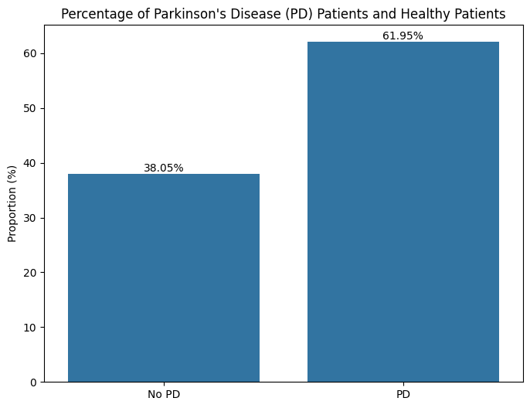
Exploratory Data Analysis

Slide 28
Exploratory Data Analysis

Slide 29
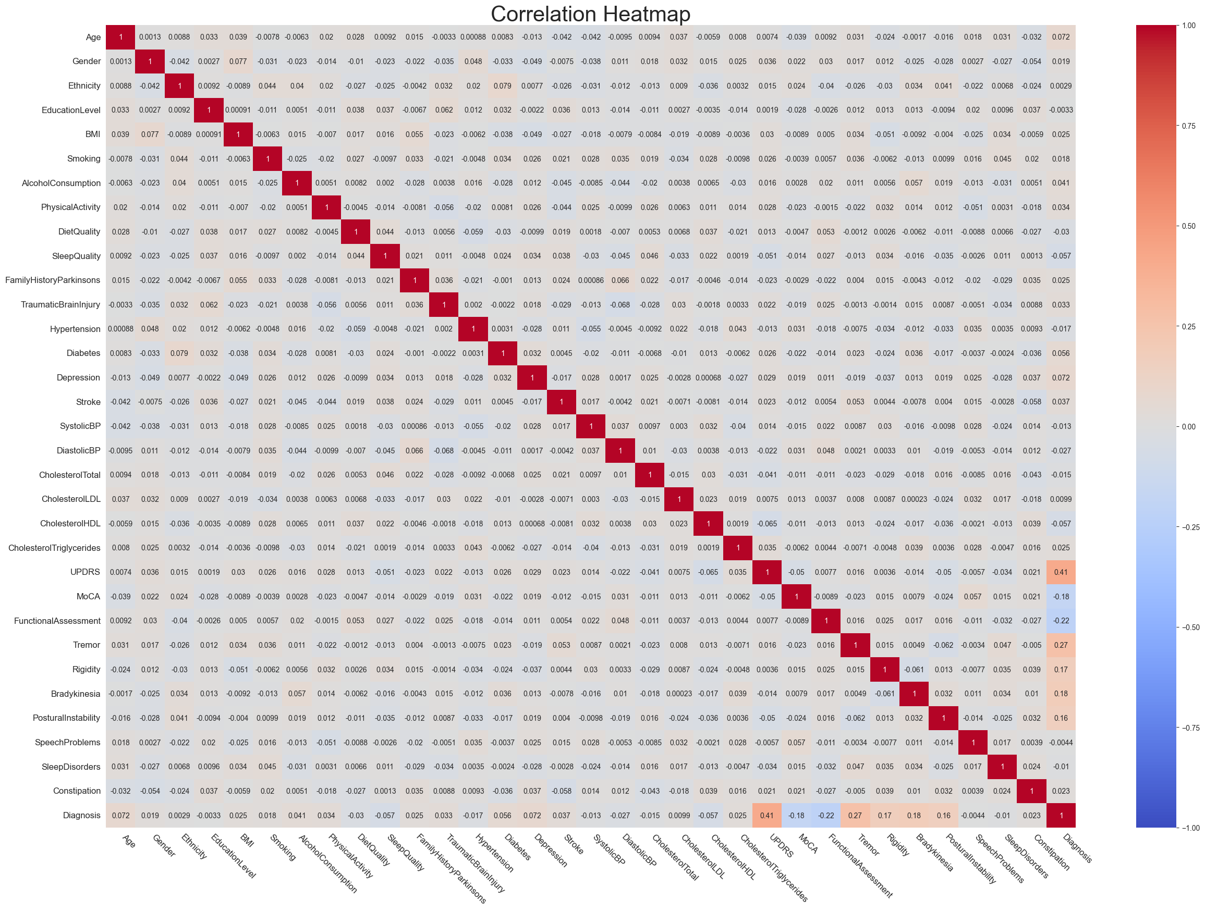
Exploratory Data Analysis

Slide 30
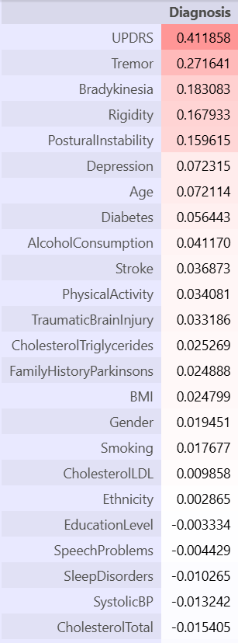
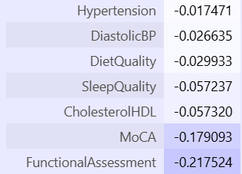
Exploratory Data Analysis

Slide 31
RESULTS: Final Models
In this project two reliable predictive models with subtle differences were developed

Slide 32
RESULTS: Final Models
In this project two reliable predictive models with subtle differences were developed
01
MODEL 1
Maximizes the accuracy score

Slide 33
RESULTS: Final Models
In this project two reliable predictive models with subtle differences were developed
01
02
MODEL 1
MODEL 2
Maximizes the accuracy score
Maximazes the sensitivity score

Slide 34
MODEL 1: Pipeline and Hyperparameters
01

Slide 35
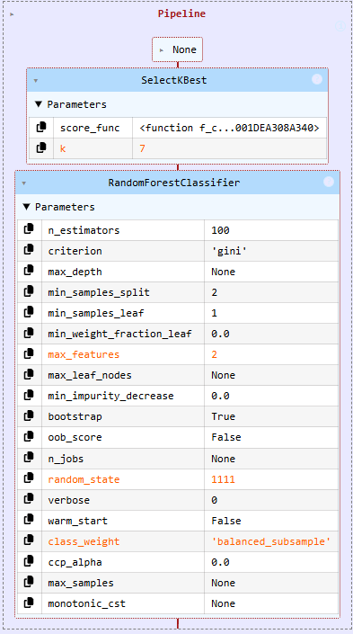
MODEL 1: Pipeline and Hyperparameters
01
Random Forest Classifier

Slide 36
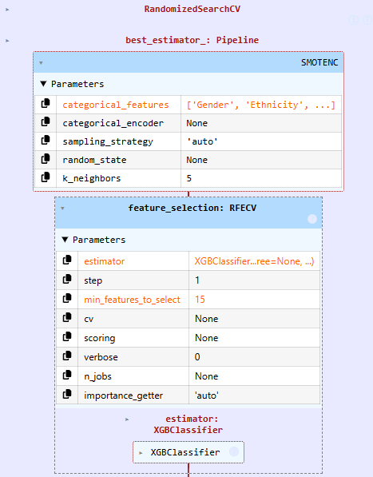
MODEL 1: Pipeline and Hyperparameters
01
Random Forest Classifier
Extreme Gradient Boosting Classifier

Slide 37
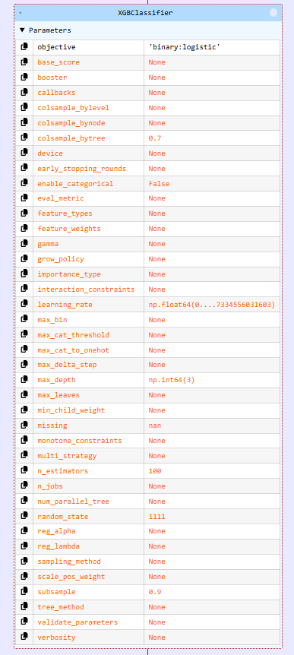
MODEL 1: Pipeline and Hyperparameters
01
Random Forest Classifier
Extreme Gradient Boosting Classifier

Slide 38
MODEL 1: Pipeline and Hyperparameters
01

Slide 39
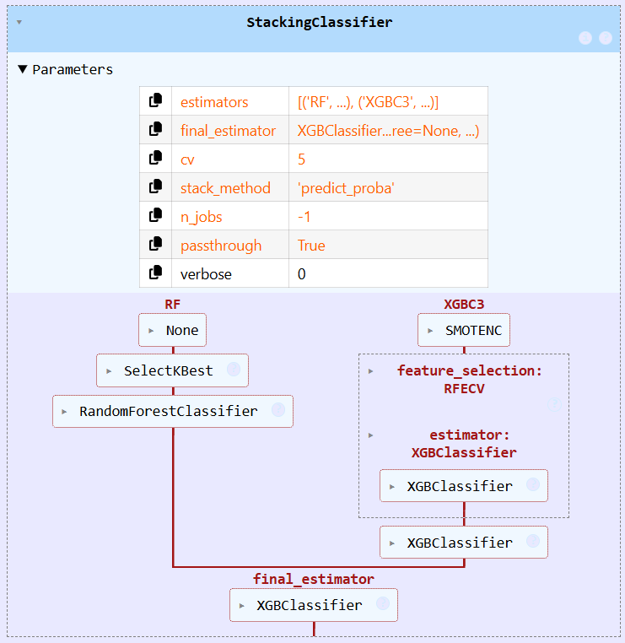
MODEL 1: Pipeline and Hyperparameters
01
Stacking Model

Slide 40
MODEL 1: Pipeline and Hyperparameters
01
Stacking Model
Greater Accuracy and Specificity Scores

Slide 41
MODEL 1: Pipeline and Hyperparameters
01
Stacking Model
Greater Recall/Sensitivity Scores
Greater Accuracy and Specificity Scores

Slide 42
MODEL 1: Test Results
01

Slide 43
MODEL 1: Test Results
01
96.9% Accuracy
This model predicted correctly 408 of 421 patients’ diagnosis

Slide 44
MODEL 1: Test Results
01
96.9% Accuracy
95.7% Specificity
This model predicted correctly 408 of 421 patients’ diagnosis
155 of 162 of the heatlhy patients were diagnosed as healthy.

Slide 45
MODEL 1: Test Results
01
96.9% Accuracy
95.7% Specificity
97.7% Sensitivity
This model predicted correctly 408 of 421 patients’ diagnosis
155 of 162 of the heatlhy patients were diagnosed as healthy.
253 of 259 Parkinson’s Disease patients were detected

Slide 46
MODEL 1: Test Results
01

Slide 47
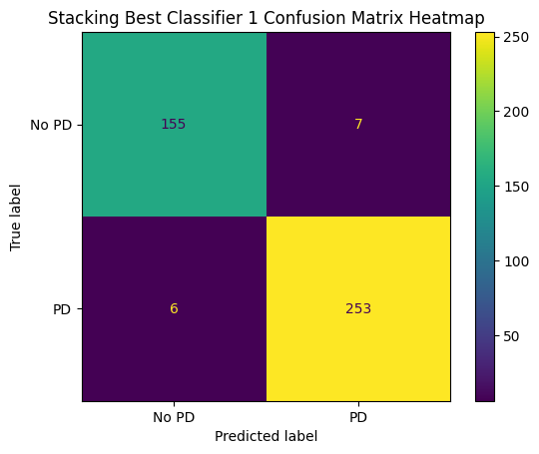
MODEL 1: Test Results
01

Slide 48
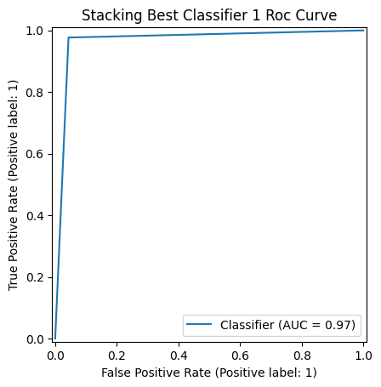
MODEL 1: Test Results
01

Slide 49
MODEL 2: Pipeline and Hyperparameters
02

Slide 50
MODEL 2: Pipeline and Hyperparameters
02
Random Forest Classifier

Slide 51
MODEL 2: Pipeline and Hyperparameters
02
Random Forest Classifier
Extreme Gradient Boosting Classifier

Slide 52
MODEL 2: Pipeline and Hyperparameters
02
Random Forest Classifier
Extreme Gradient Boosting Classifier

Slide 53
MODEL 2: Pipeline and Hyperparameters
02
Stacking Model

Slide 54
MODEL 2: Test Results
01
02

Slide 55
MODEL 2: Test Results
02
96.4% Accuracy
This model predicted correctly 406 of 421 patients’ diagnosis

Slide 56
MODEL 2: Test Results
02
96.4% Accuracy
93.8% Specificity
This model predicted correctly 406 of 421 patients’ diagnosis
152 of 162 of the heatlhy patients were diagnosed as healthy.

Slide 57
MODEL 2: Test Results
02
96.4% Accuracy
93.8% Specificity
98.1% Sensitivity
This model predicted correctly 406 of 421 patients’ diagnosis
152 of 162 of the heatlhy patients were diagnosed as healthy.
254 of 259 Parkinson’s Disease patients were detected

Slide 58

MODEL 2: Test Results
01
02

Slide 59
MODEL 2: Test Results
01
02

Slide 60
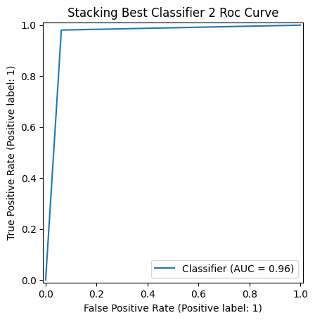
MODEL 2: Test Results
01
02

Slide 61
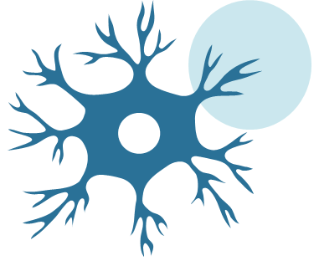
Conclusions

Slide 62
Conclusions
Two machine learning predictive models with impresive performance were developed sucessfully.

Slide 63
Conclusions
Two machine learning predictive models with impresive performance were developed sucessfully.
These models can support clinicians in recognizing subtle signs that might otherwise go unnoticed, gain deeper insight into the complex interactions that contribute to neurodegenerative disorders and reach more personalized and proactive patient care.

Slide 64
Conclusions
Two machine learning predictive models with impresive performance were developed sucessfully.
These models can support clinicians in recognizing subtle signs that might otherwise go unnoticed, gain deeper insight into the complex interactions that contribute to neurodegenerative disorders and reach more personalized and proactive patient care.
Timely diagnosis will improve the effectiveness of available therapeutic interventions, influencing patient outcomes and long-term quality of life.

Slide 65
Strenghs and Limitations
Stenghs
Predictive models obtained impresive sensitivity scores (~98%). Components of the model are scalable and fast-performing, allowing fast prediction of huge datasets in seconds. Models has great flexibility. Consequently it can be adjusted and re-trained with new data with training times of less than one minute in train dataset of 2000 registers.

Slide 66
Strenghs and Limitations
Stenghs
Predictive models obtained impresive sensitivity scores (~98%). Components of the model are scalable and fast-performing, allowing fast prediction of huge datasets in seconds. Models has great flexibility. Consequently it can be adjusted and re-trained with new data with training times of less than one minute in train dataset of 2000 registers.
Limitations
Although the models obtained impresive sensitivity scores (~98%), specificity was compromised (93-96%), leading to some healthy patients incorrectly diagnosed as Parkinson’s Disease patients. The model has not been tested in datasets with missing values.

Slide 67




THANKS FOR YOUR ATTENTION
Github Repository
Streamlit Webpage

